Slide 1
“Telepathic” Quantum Imaging, Entanglement and Fractal Space-Time: A Return to Schrödinger’s Cat!
Mohammed A Z Habeeb
Dept of Physics, College of Science, Al-Nahrain University
Some Brief History
What is “Telepathic” Quantum Imaging?
Schrödinger's Cat & Her Cousins!
Quantum Entanglement
Fractal Space-Time
Skepticism
Futuristic Prospects
Learning an Old Lesson

Slide 2
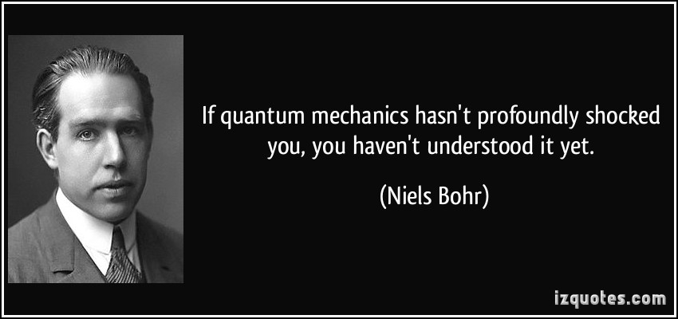
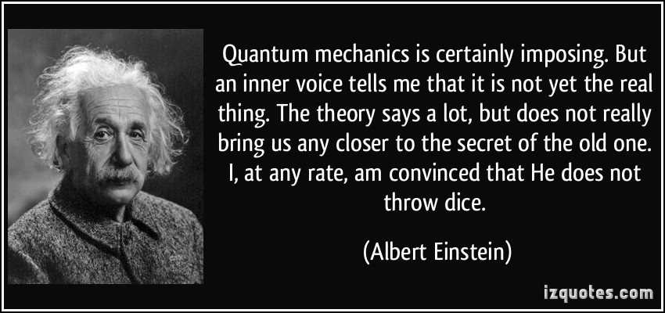
Some History of the Quantum

Slide 3
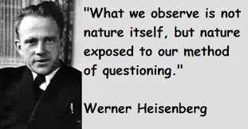
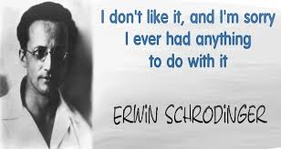

Slide 4
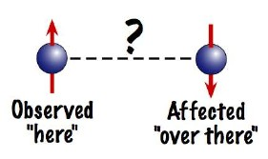
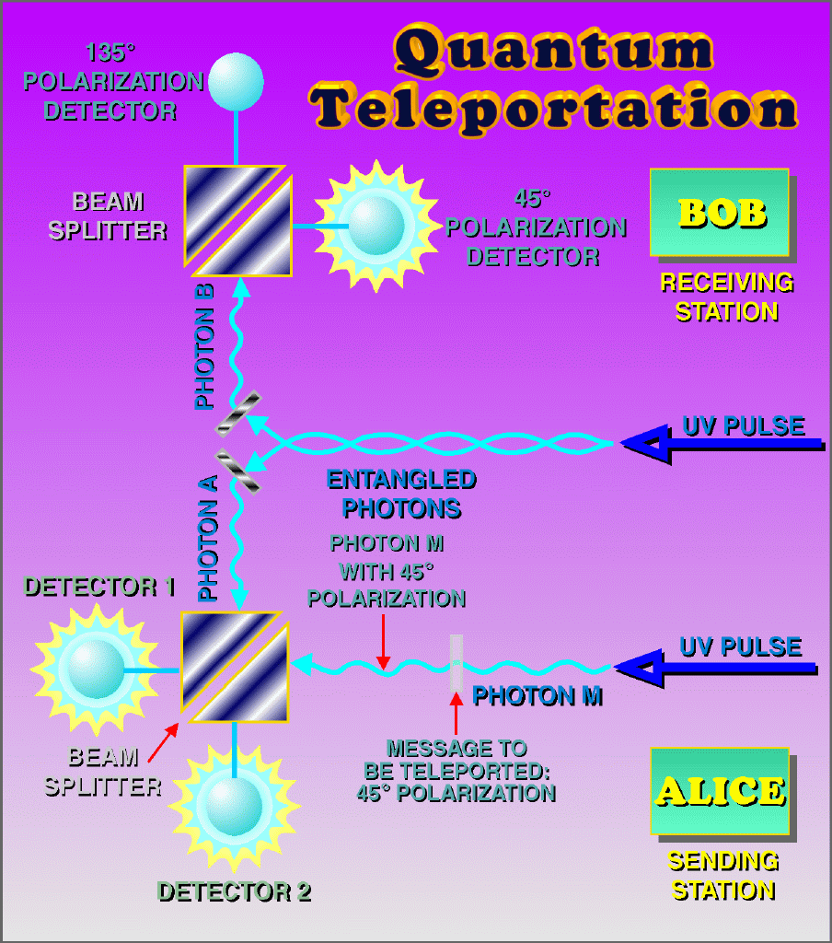
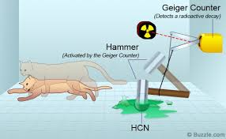
Einstein: “Spooky Action at a Distance”
(~ 1935)
Entanglement
Quantum Teleportation! Bits Vanish Here, Reappear There.
The Paradox of Schrönginer’s Cat!
(~1990s)
(~ 1935)

Slide 5
Telepathic Quantum Imaging
What is Imaging?
Imaging Goes Quantum!
Previous Successes.
Very Recent Achievement:
“Quantum Imaging With Undetected Photons”
G B Lemos, V Borish, G D Cole, S Ramelow, R Lapkiewics
and A Zeilinger (IQOQI,VCQST,UoV, Austria),
Nature, Letter, 27th August, 2014.
“Telepathic Quantum” Imaging
Entangled Photons Make a Picture from a Paradox
Casper the Quantum Ghost
Quantum Imaging Finally Saves Schrönginer’s Cat
“Spooky” Quantum Entanglement Reveals Invisible
Objects
Blind Quantum Camera Snaps Photos of Schrönginer’s Cat
Schrönginer’s Cat Has Been Caught on Quantum Film

Slide 6
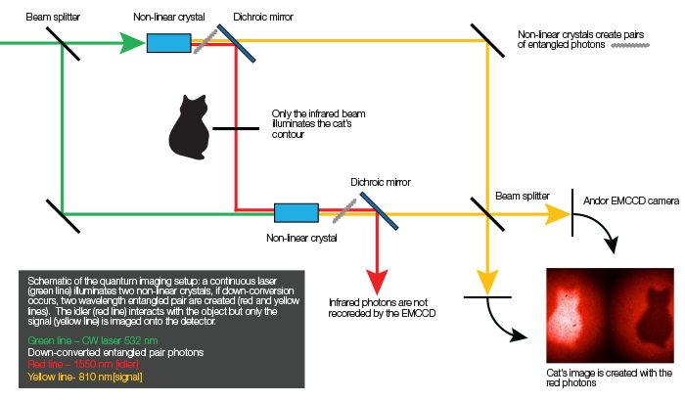
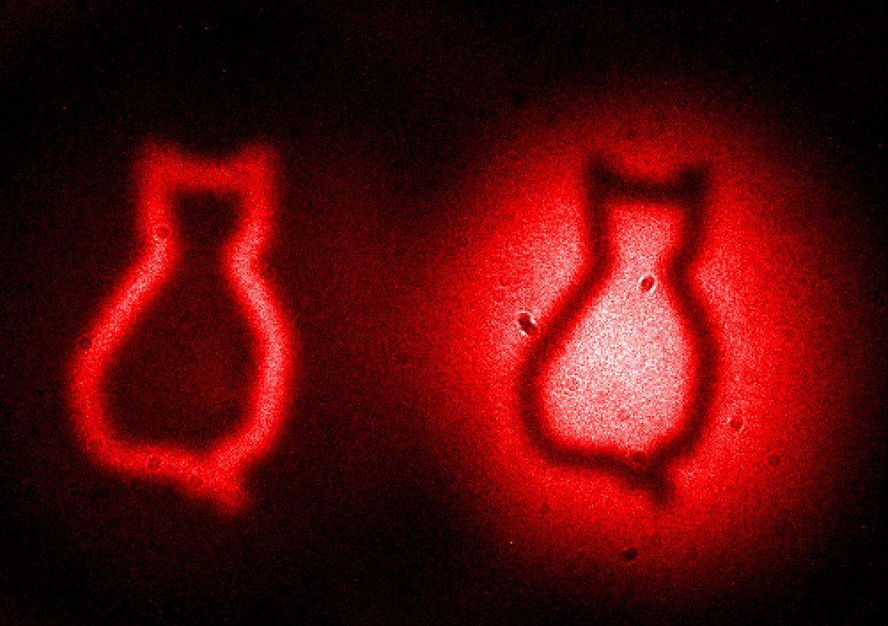
What is “Telepathic” Imaging?
Quantum “Telepathic” Photo of
Schrödinger’s Cat
(27th August, 2014)

Slide 7
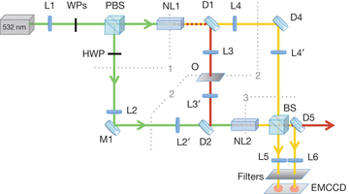
Actual Experimental Setup
Photons that illuminate the imaged object are never detected and their sisters that are detected never touch the object

Slide 8
“Indistinguishable quantum states interfere, but the mere possibility of obtaining information that could distinguish between overlapping states inhibits quantum interference.”
“Quantum interference imaging can outperform classical imaging or even have entirely new features.”
“This imaging technique relies on the indistinguishability of the possible sources of a photon that remains undetected.”
“While the photons passing through the object are never detected, images are obtained exclusively with the sister photons that do not interact with the object. Therefore, the object to be imaged can be either opaque or invisible to the detected photons.”
“Moreover, this technique allows the probe wavelength to be chosen in a range for which suitable sources and/or detectors are unavailable.”
This looks like MAGIC!
Knowledge can be extracted by and about a photon that is
never detected All sorts of bizarre things become possible
A Prototype of an Experiment in Quantum Information

Slide 9
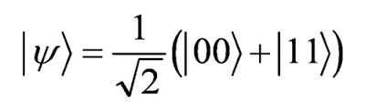
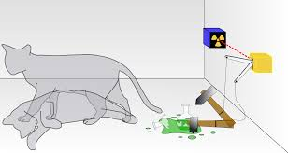
The Story of Schrödinger’s Cat
and Her Cousins
In quantum computing the phrase "cat state" often refers to the special entanglement of qubits wherein the qubits are in an equal superposition of all being 0 and all being 1; e.g.,

Slide 10
Her Laboratory Cousins:
Antony Legget, Noble Prize in Physics, (2003)
UoV Lecture, Vienna, 1986.
So, What are Her Laboratory Cousins?
Some interesting very recent speculation on the Journal of Nuclear Physics:
“Apparently, atomic clocks can now do more than just keep accurate time (as in GPS satellites). Now, they can be used to perform quantum simulations. Perhaps, a team could simulate and improve the quantum E-Cat (a cousin to Schrödinger’s cat?).
“Maybe, such quantum simulations might help settle some of the disputes.”
“Very interesting. Of course, the E-Cat is a cousin of Schrödinger’s cat! By the way: as it will turn out when the scientific principle of this effect will be made public, the E-Cat respects perfectly the well known physics laws and most accredited theories. This means: there is no need of any ‘new physics’, everything is well contained in the well known physics: therefore of course, the E-Cat is a cousin of the Schrödinger’s cat! …”

Slide 11
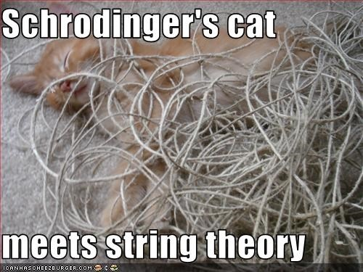
DNA molecular cousin of Schrödinger's cat: A curious example of quantum measurement.
Home D, Chattopadhyaya R
Physical review letters 76:16 1996 Apr 15 pg 2836-283
The Double Quantum Dot Feline Cousin of Schrödinger's Cat: An
Experimental Testbed for a Discourse on Quantum Measurement Dichotomies
S. Bandyopadhyay
Department of Electrical Engineering, University of Nebraska, Lincoln, Nebraska 68588-0511

Slide 12
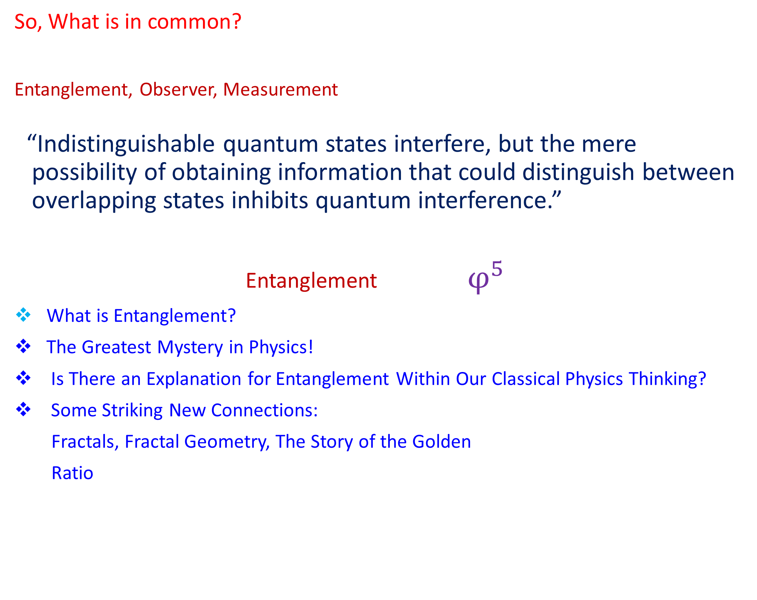



Slide 13
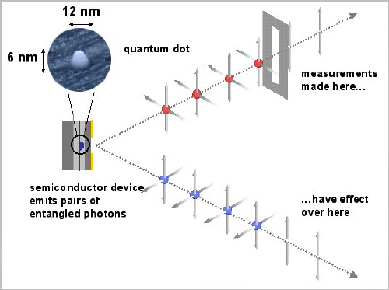

Slide 14
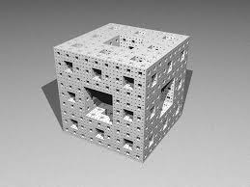
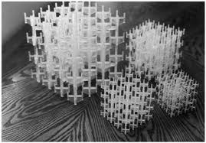
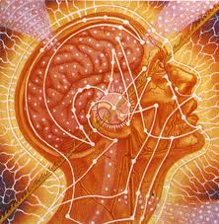
Structure of Space-Time
Space and Time← Newton
Space-Time ← Einstein
Geometry of Space-Time
Euclidean
Riemannian
Fractal
What is Fractal Space-Time?
Fractal Space-Time Emerges from Entanglement
"A metaphorical chip holding all the programming for our universe stores information like a quantum computer." This is the radical insight to the foundation of our Universe developed
by Mark Van Raamsdonk 2014, Canada

Slide 15
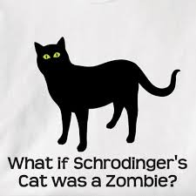
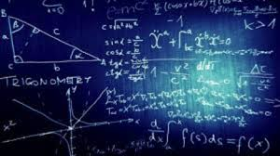
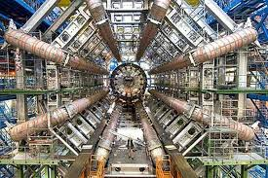
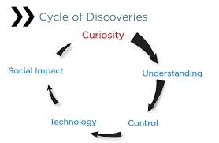

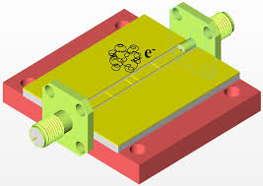
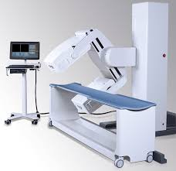
Skepticism
Alternative Explanations for the New Experiment on Quantum Imaging!
???
Futuristic Prospects
Applications of Telepathic Quantum Imaging: Medicine, … .
???
Learning an Old Lesson
How Weird Ideas are Transformed Into Realities:
How Basic Research Affects Our Lives:

